Slide 1
Website Gadget Development Platform
Webgad Team

Slide 2
Webgad Team
Nguyễn Xuân Chức
Nguyễn Thanh Sơn
Tô Quang Duy
Nguyễn Văn Vũ
Nguyễn Ngọc Lâm

Slide 3
Overview
Introduction
Project management plan
Software requirement specification
Software design
Software testing
QA & Demo

Slide 4
Introduction
1

Slide 5
Introduction
Background
Problem and literature review
Our proposal

Slide 6
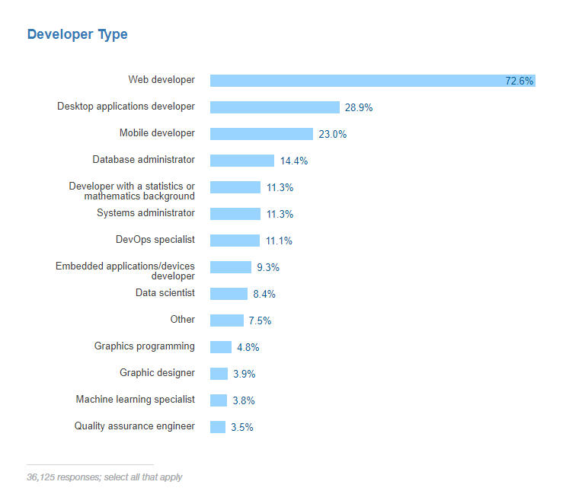
Introduction
Background

Slide 7

Introduction
What is a Gadget?

Slide 8
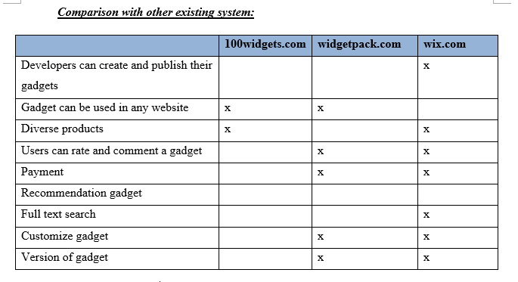
Introduction
2. Problem & literature review

Slide 9
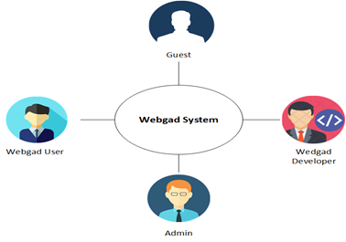
Introduction
3. Our proposal

Slide 10
Software Project Management Plan
2

Slide 11
Software Project Management Plan
Organization structure
Software process model
Project schedule
Tools and Software
Risk management plan
Communication plan

Slide 12
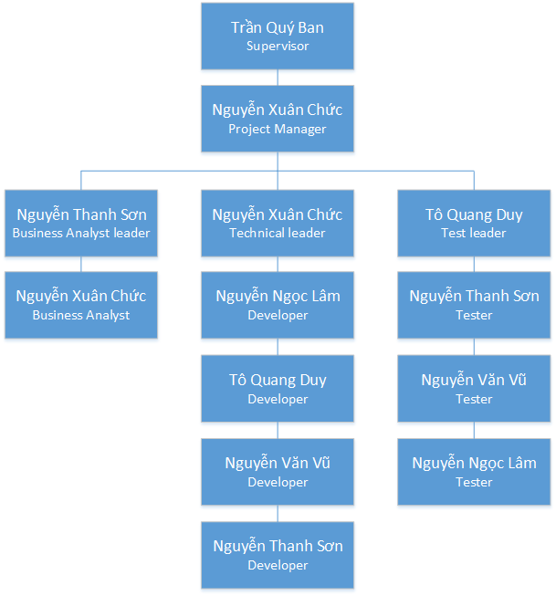
Software Project Management Plan
Organization structure

Slide 13
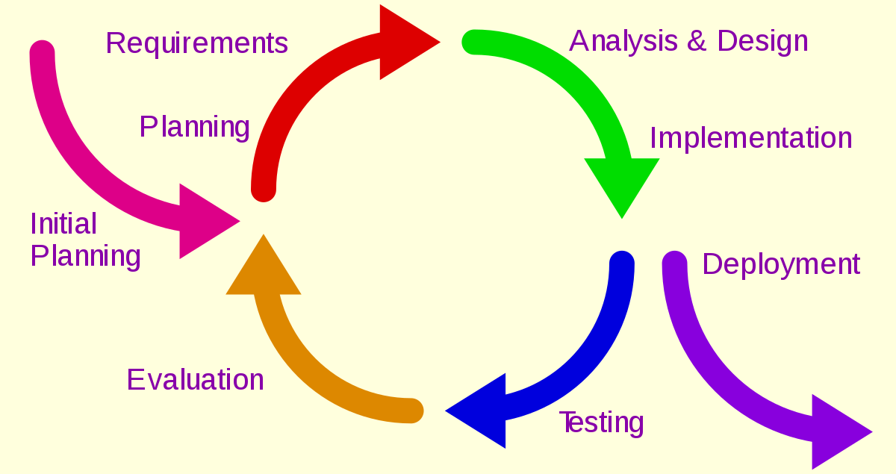
Software Project Management Plan
Software process model
Iterative development model

Slide 14
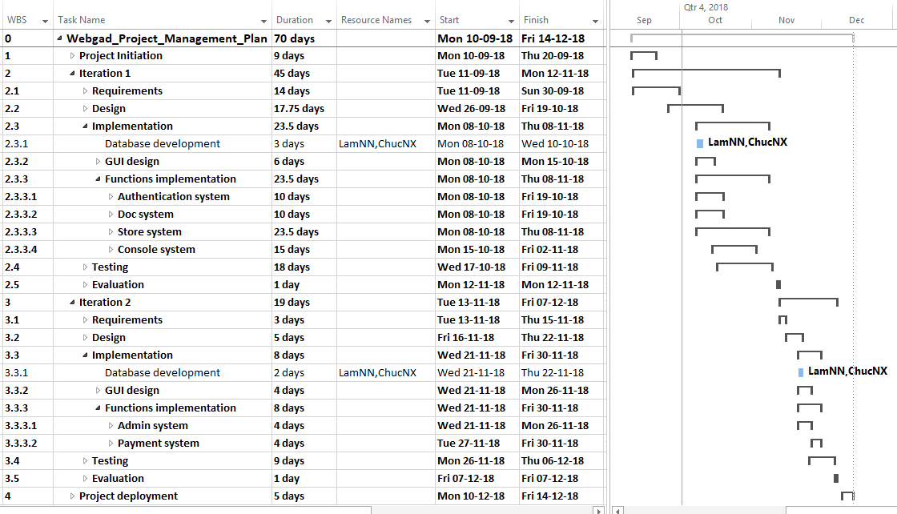
Software Project Management Plan
Project schedule

Slide 15
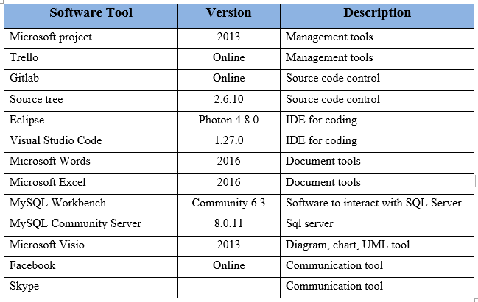
Software Project Management Plan
Tools and Software

Slide 16
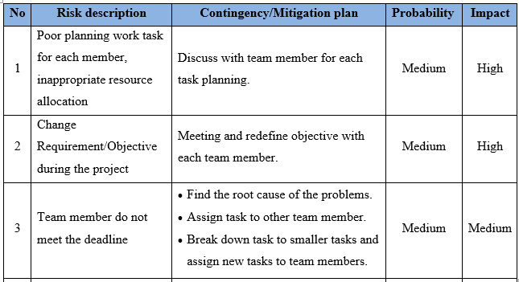
Software Project Management Plan
Risk management plan
Risk identification

Slide 17
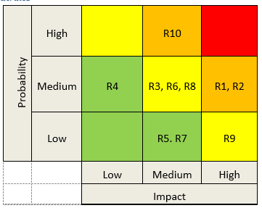
Software Project Management Plan
Risk management plan
Probability/Impact matrixes

Slide 18
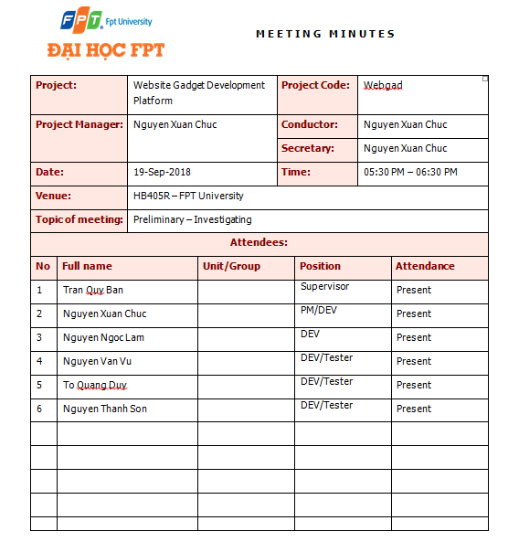
Software Project Management Plan
Communication plan
Daily report
Weekly report

Slide 19
Software Requirement Specification
3

Slide 20
Software requirement specification
User requirement
System requirement
Non-functional requirement

Slide 21
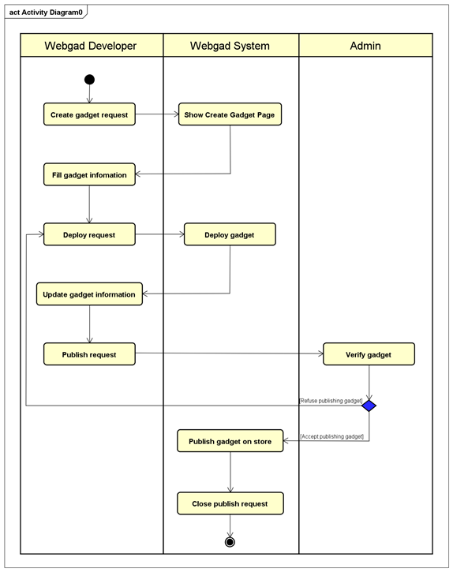
Software requirement specification
1. User requirement
Business process diagram
Notes:
Sơ đồ nghiệp vụ phát triển một gadget trên hệ thống

Slide 22
Software requirement specification
1. User requirement
Main function:
Webgad Account
Webgad Store
Webgad Console
Webgad Admin
Mongo client library
Notes:
Chứa các chức năng quản lý người dùng trong hệ thống
Chứa các chức năng tìm kiếm, mua và cài đặt các tiện ích
Dành cho các nhà phát triển để phát triển các tiện ích
Chứa các phương thức kiểm định các tiện ích mới và xử lý các khiếu nại của người dùng
Thư viện giúp kết nối các tiện ích với ko gian lưu trữ db của tiện ích đó trên hệ thống của chúng em

Slide 23




Software requirement specification
2. System requirement
User interface
Hardware interface
Software interface
Communication

Slide 24
Software requirement specification
3. Non-functional requirement
Security
Performance
Usability
Maintainability & Scalability
Notes:
Tính bảo mật
Tính hiệu suất
Tính dễ sử dụng
Khả năng bảo trì và mở rộng hệ thống

Slide 25
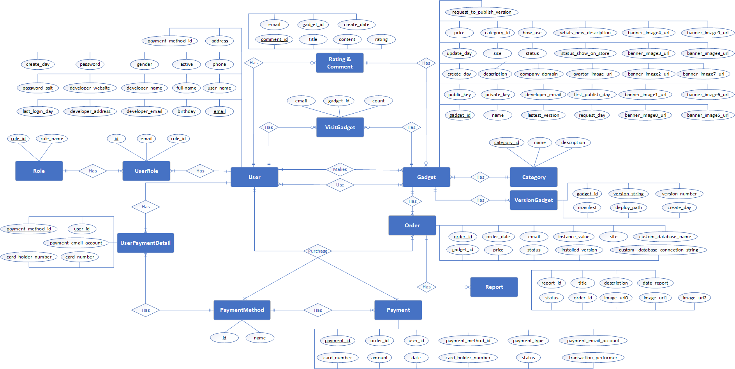
Software requirement specification
4. ERD

Slide 26
Software Design
4

Slide 27
Software Design
High-level design
Interaction design
Detail design
Activity design
Database design
Recommendation implement detail

Slide 28
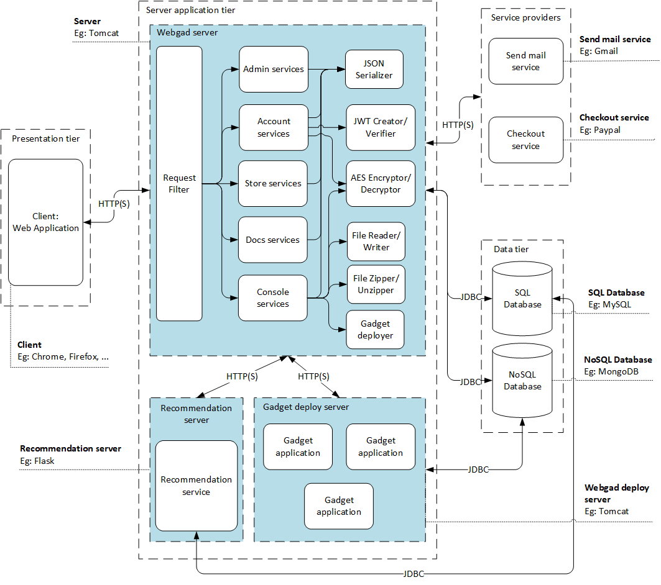
Software Design
High-level design
System Architecture

Slide 29
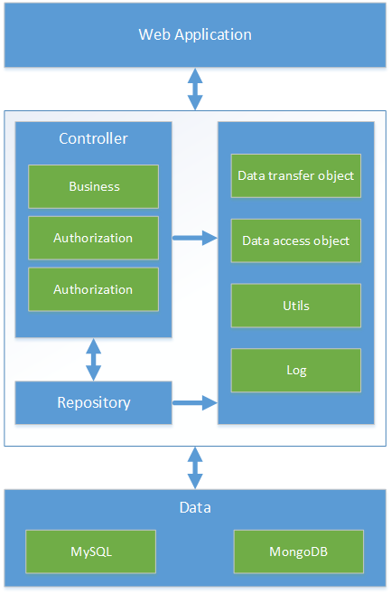
Software Design
High-level design
Layer diagram

Slide 30
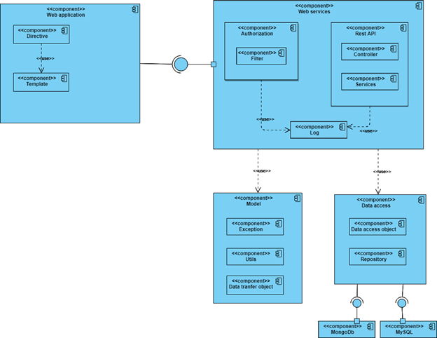
Software Design
High-level design
Component diagram

Slide 31
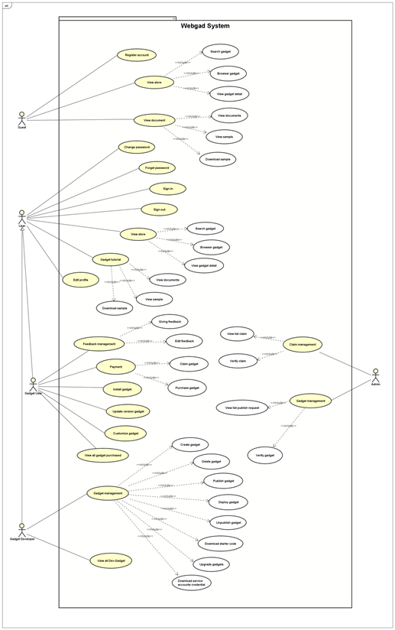
Software Design
Interaction design
Use case diagram

Slide 32
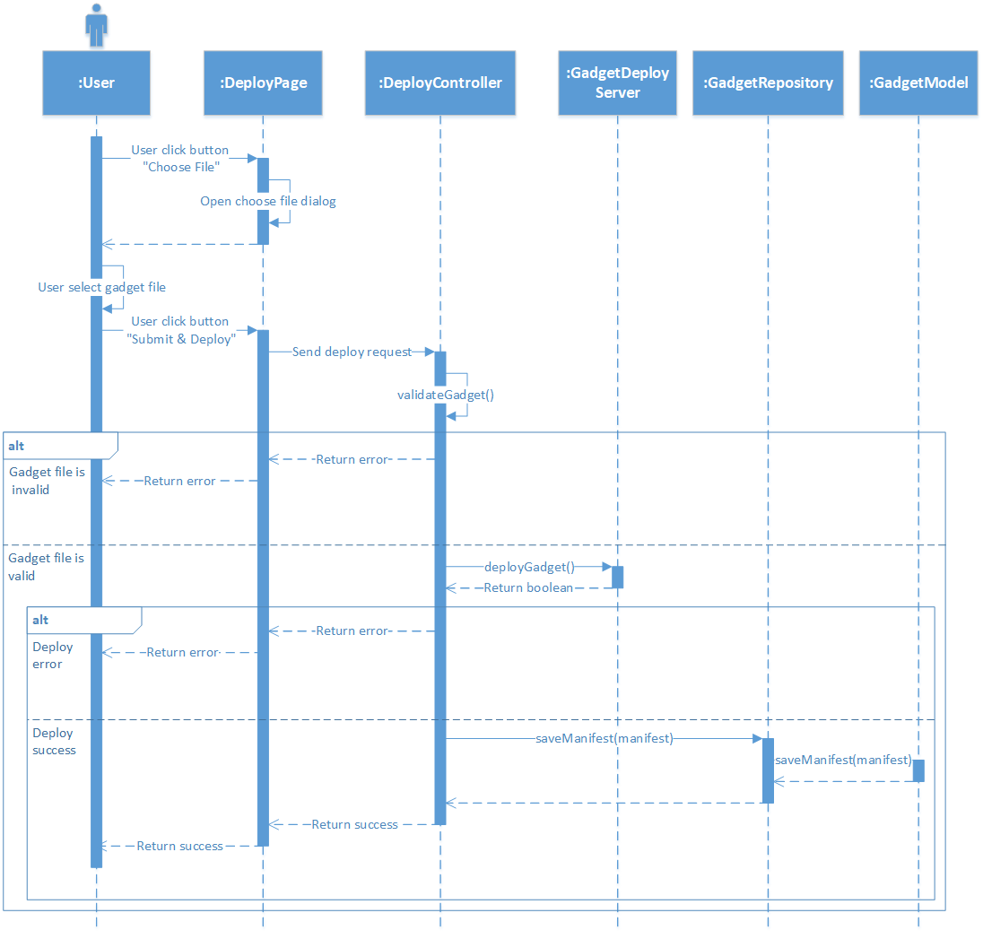
Software Design
Interaction design
Sequence diagram

Slide 33
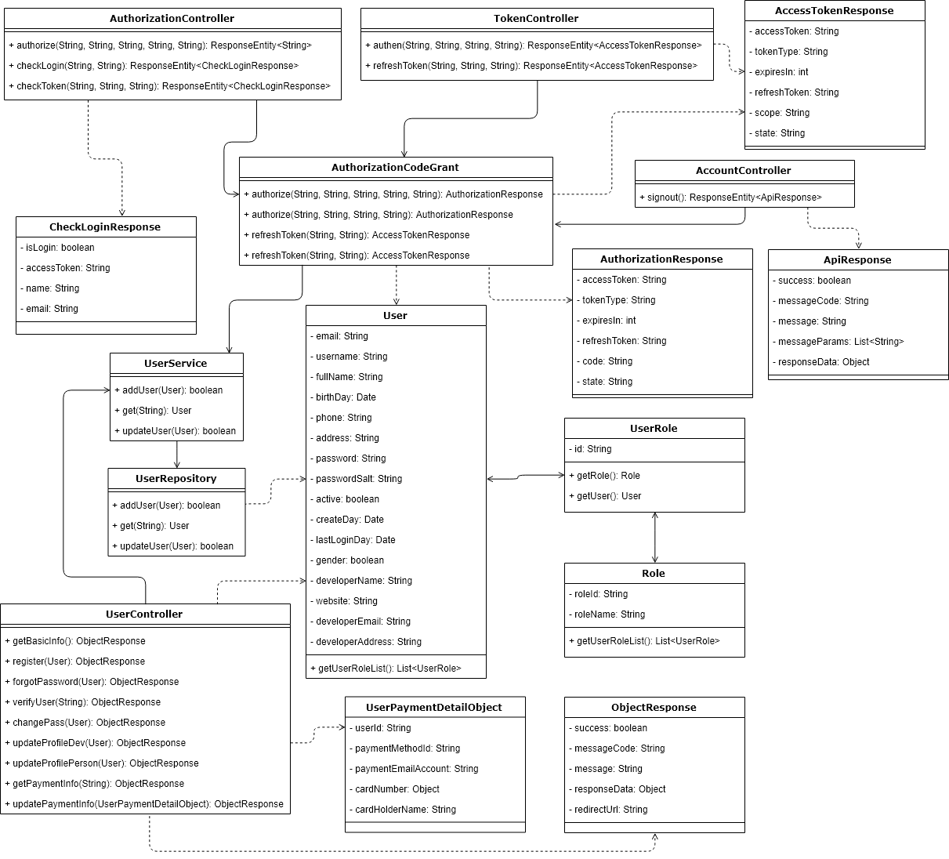
Software Design
3. Detail design
Class diagram
Notes:
Account module

Slide 34
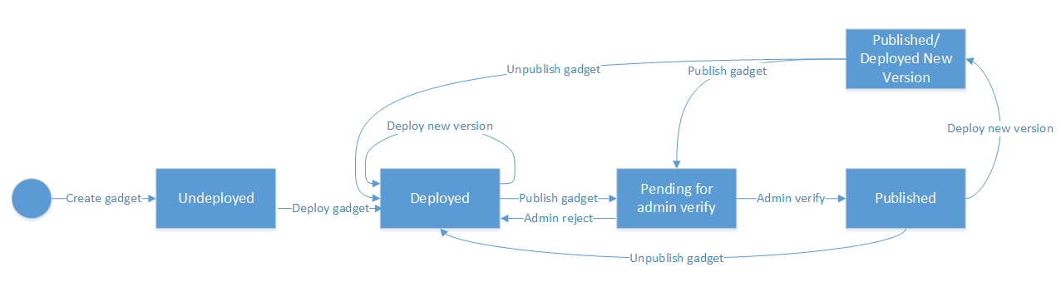
Software Design
4. Activity design
State diagram

Slide 35
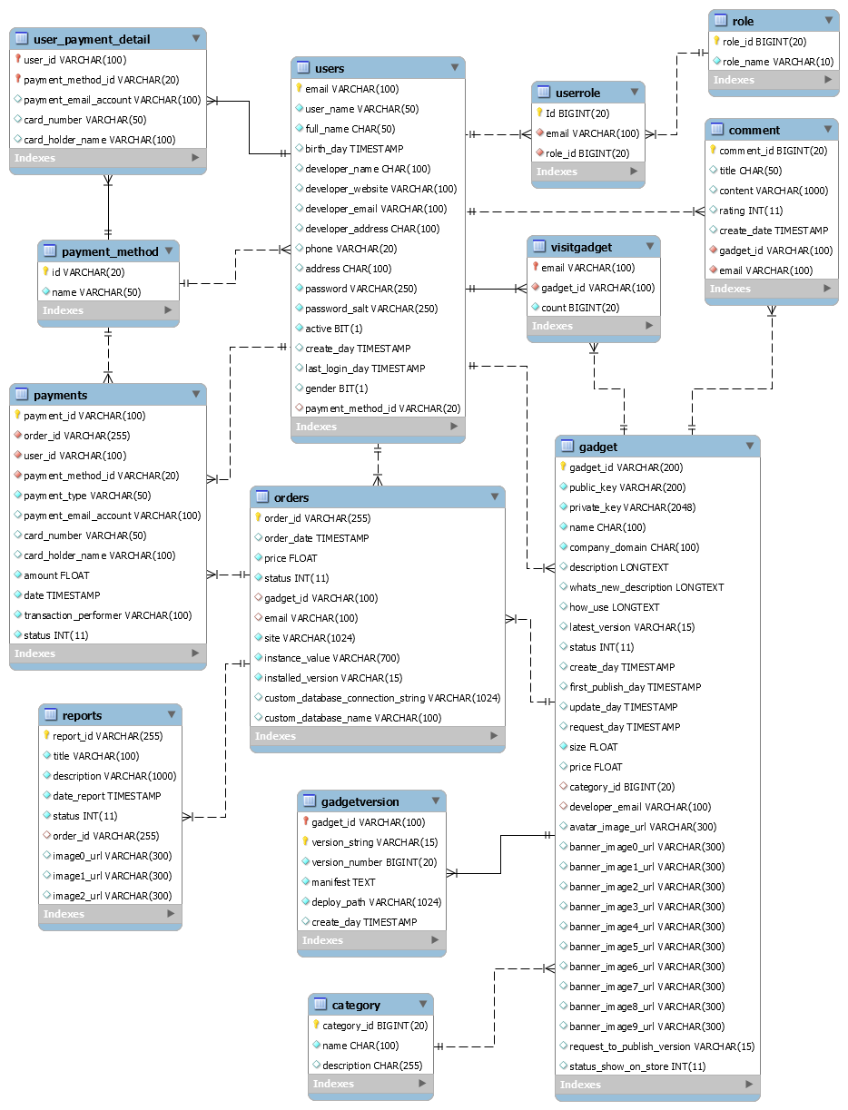
Software Design
5. Database design

Slide 36

Software Design
6. Recommendation implementation detail

Slide 37
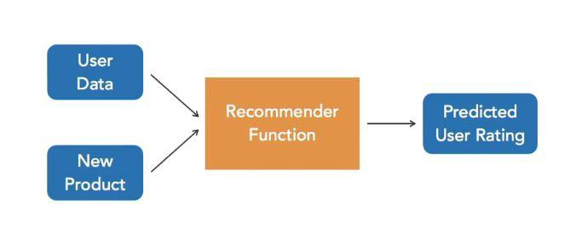
Software Design

Slide 38
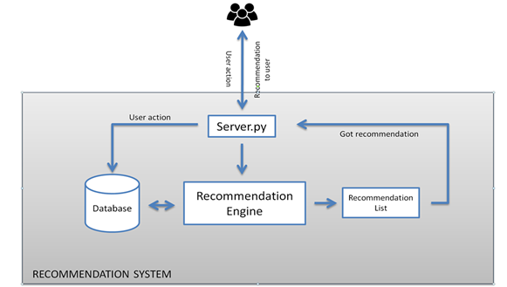
Software Design
Recommendation System Architecture

Slide 39

Software Design
The data can be collected by two means: explicitly and implicitly.
Explicit data
Implicit data

Slide 40

Software Design
Majorly 2 types of filtering methodology is used

Slide 41
Software Design
Content based filtering methodology
CountVectorizer convert corpus to a matrix of token counts and build a vocabulary of known words
 | chatbot | mail | website | gadget | auto
Chatbot auto reply | 1 | 0 | 0 | 0 | 1
Mail gadget for website | 0 | 1 | 1 | 1 | 0

Slide 42
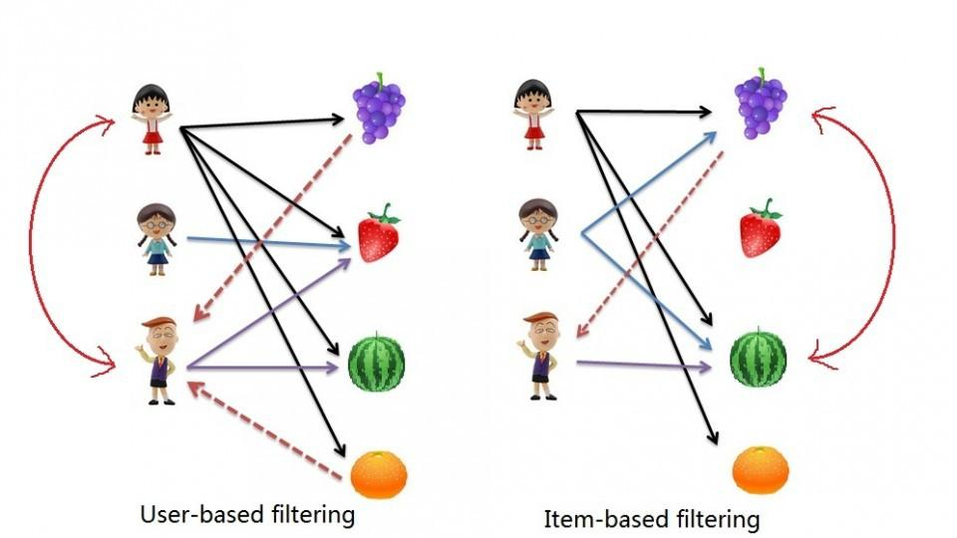
Software Design
Collaborative filtering methodology

Slide 43
Software Design
Item based collaborative filtering methodology
 | Item 0 | Item 1 | Item 2 | Item 3 | Item 4
Item 0 | 1 | 0.77 | 0.49 | -0.88 | -0.52
Item 1 | 0.77 | 1 | 0 | -0.64 | -0.14
Item 2 | 0.49 | 0 | 1 | -0.55 | -0.88
Item 3 | -0.89 | -0.64 | -0.55 | 1 | 0.68
Item 4 | -0.52 | -0.14 | -0.88 | 0.68 | 1
Similarity matrix

Slide 44
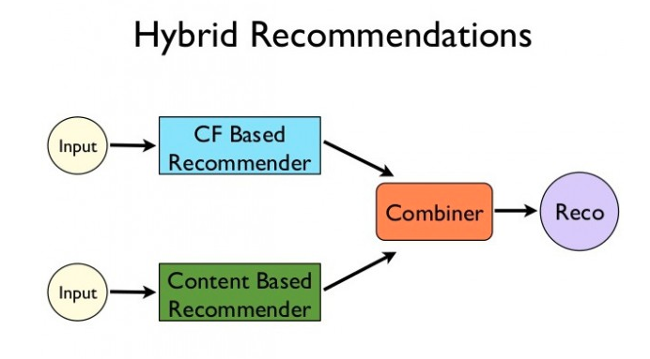
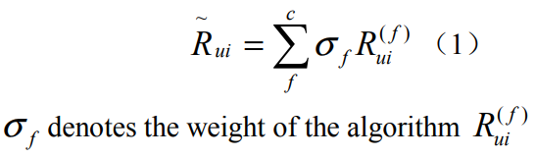
Hybrid filtering methodology

Slide 45
Software Testing
5

Slide 46
Software Testing
Testing Strategy
Acceptance criteria
No | Acceptance criteria | Note
1 | All unit test case must be tested at least once.
2 | All integration test case must be tested at least once.
3 | All of high severity defects have been closed.

Slide 47
Software Testing
Testing Environment
No | Name | Version | Description
1 | Google chrome | 70.0.3538.77 | Integration testing
2 | Window 10 | 1809

Slide 48
Software Testing
Testing Tools
No | Name | Version | Description
1 | Junit library | 4.21 | Java unit test
2 | Eclipse Java EE IDE | 4.8.0 | IDE for java unit test
3 | Microsoft excel | 16.0.6741.2048 | Test case & Test report
4 | Google sheets | Online | Log bug

Slide 49
Software Testing
Testing Strategy
Test level | Type of test
 | White box | Black box
Unit test | √
Integration test |  | √
Acceptance test |  | √

Slide 50
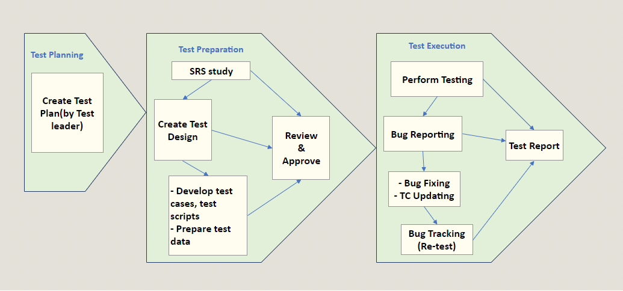
Software Testing
Testing Strategy
Test process

Slide 51
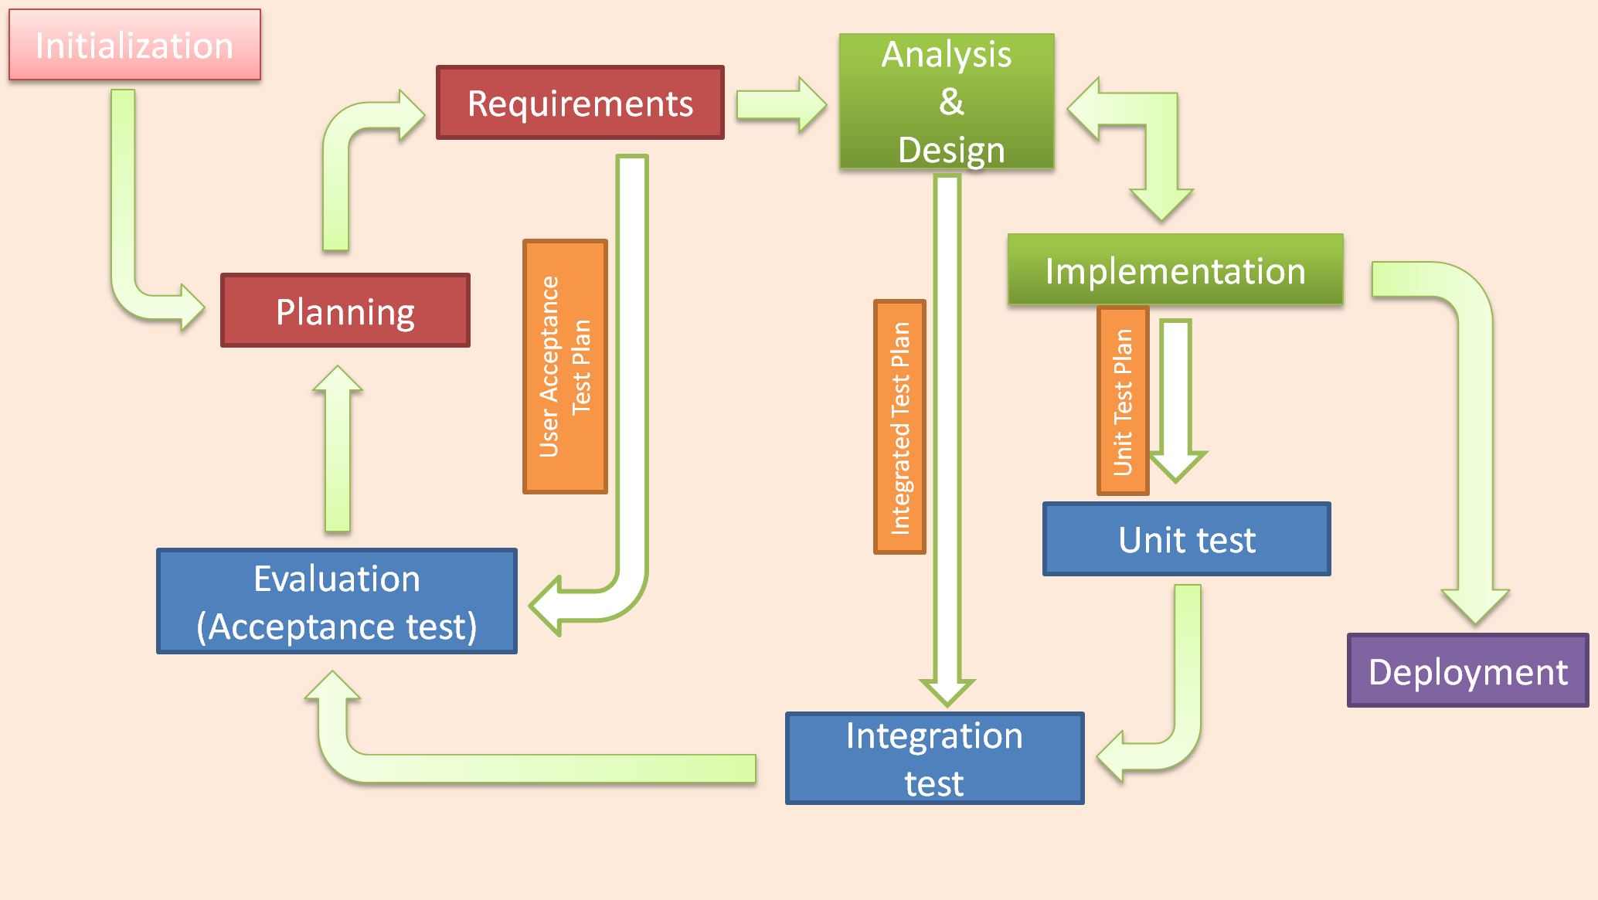
Software Testing
Testing Model
Iterative testing model
Notes:
Mô hình test phải follow mô hình code. Do mô hình code của bọn em là iterative model nên mô hình test của bọn em cũng là iterative model.

Slide 52
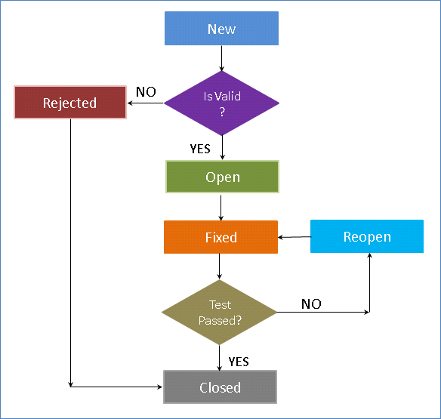
Software Testing
Defect Log
Defect life cycle

Slide 53
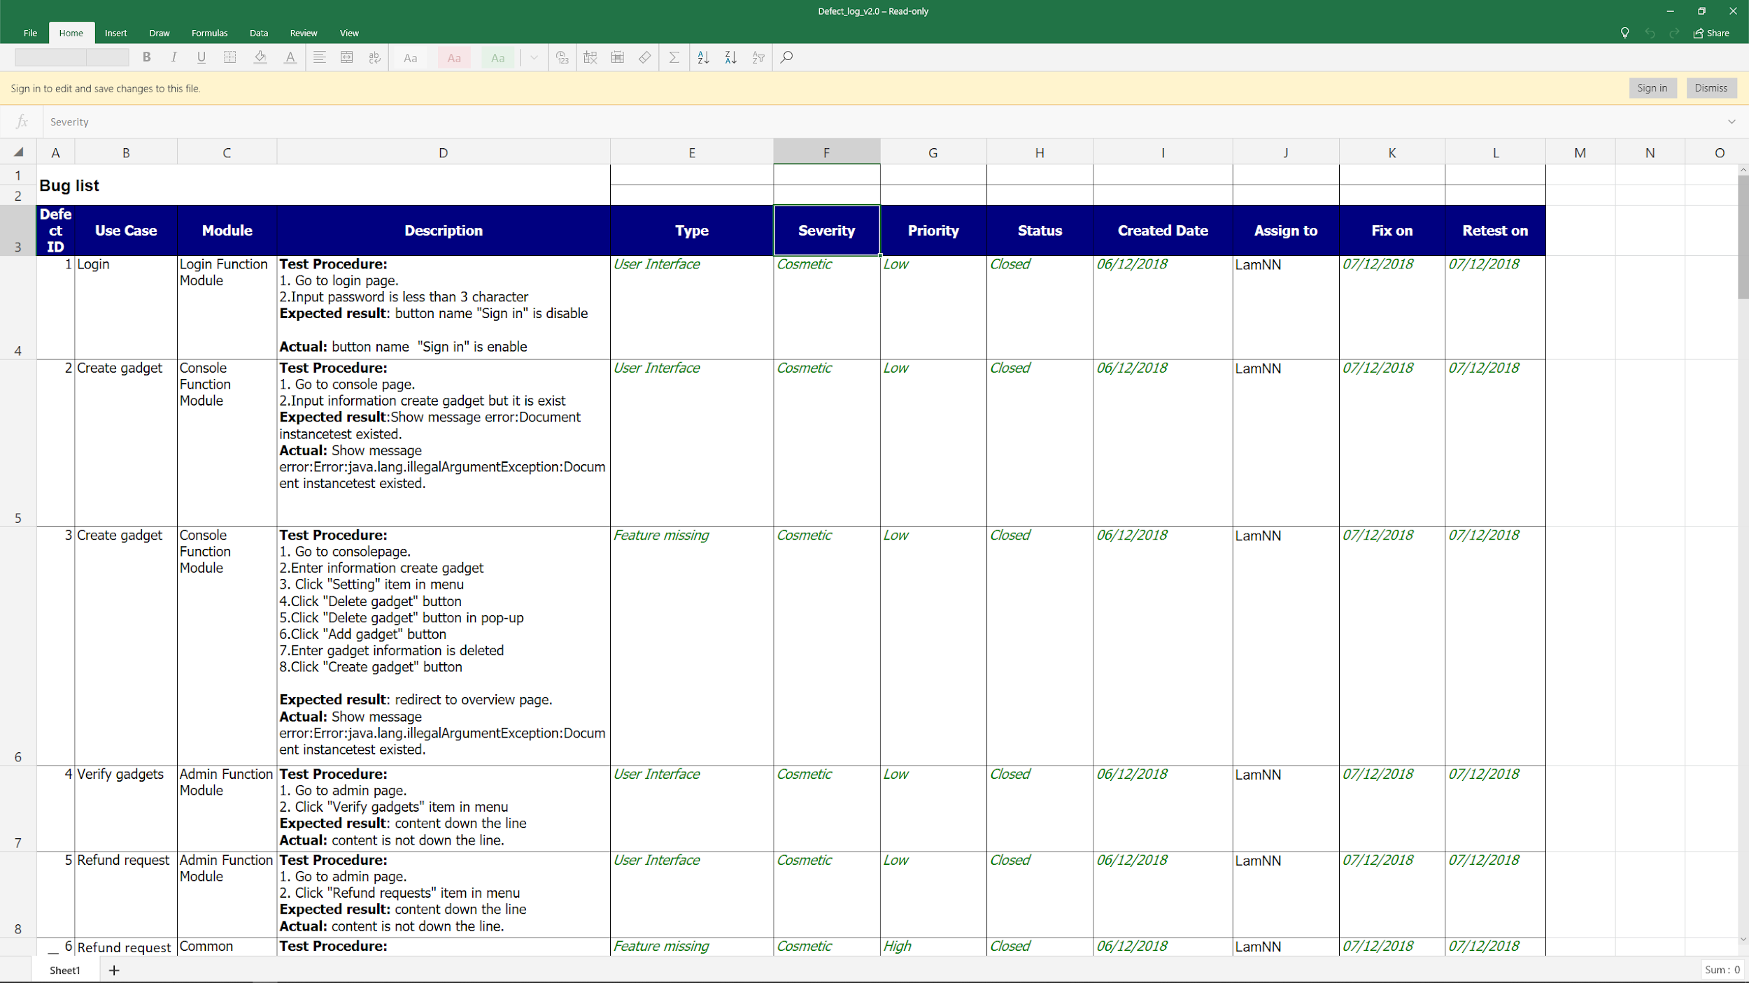
Software Testing
Defect Log
Defect log sample

Slide 54
Software Testing
Test report
Stage Of Test |  | Stage 1 |  | Stage 2 |  | Final
 |  | Pass | Fail | Pass | Fail
Unit Test Case | Account module | 45 | 18 | 63 | 0 | 63
 | Admin module | 25 | 8 | 33 | 0 | 33
 | Console module | 19 | 2 | 21 | 0 | 21
 | Store module | 40 | 8 | 48 | 0 | 48
Integration Test Case |  | 585 | 54 | 639 | 0 | 639
Total |  | 714 | 90 | 804 | 0 | 804
Test execution: 100%
Pass: 100%

Slide 55
QA & Demo
6

